Slide 1


Evaluating the effect of UNDP livelihood programmes on life and choices made by Syrian refugee and Jordanian populations in communities in Jordan.
Capturing and visualizing perceptions overtime

Slide 2
The project
Create sustainable livelihood skills and opportunities for unskilled workers, refugees and socially vulnerable groups, as part of a larger strategy to improve economic outcomes, increase resilience and prevent violent extremism.

Slide 3
Three programmes were put in place in three chosen governorates:
Zarqa | Emergency Employment Project through the 3X6 approach | Jordanian beneficiaries only
Irbid | Skills Exchange of Vulnerable Hosting Communities and Syrian Refugees for Enhancing Livelihoods and Social Cohesion | Jordanian, Syrian beneficiaries
Mafraq | Skills Exchange of Vulnerable Hosting Communities and Syrian Refugees for Enhancing Livelihoods and Social Cohesion | Jordanian, Syrian beneficiaries

Slide 4
Total data collection
IRBID:
904 Women:871 Men
1170 Jordanian:605 Syrian
860 direct beneficiaries:
915 indirect beneficiaries
MAFRAQ:
338 Women:219 Men
396 Jordanian: 181 Syrian
553 direct beneficiaries
ZARQA:
901 Women:653 Men
1554 Jordanian: 0 Syrian
728 direct beneficiaries: 820 indirect beneficiaries

Slide 5
Our role
Use non-direct micro-narrative evaluation methods:
To conduct diagnostic research to understand needs of host community members that will inform the design of ongoing UNDP projects;
To produce comparative analysis of data to assess the effects of the programme on direct beneficiaries, indirect beneficiaries and other community members.

Slide 6
Summary of the study
Format of the study: | Evaluation: baseline, endline
Respondents: | Jordanian community members, Syrian refugees living in Jordanian communities.
Respondent groups: | Direct beneficiaries (registered training recipients), Indirect beneficiaries (family members of direct beneficiaries, community members).
Geography: | Governorates: Mafraq, Irbid, Zarqa.
Timeframe: | Baseline collection aligned with direct beneficiary selection; endline collection took place within a specified time after graduation.
Collection team: | A trained team of 10-12 collectors coordinated by a Jordan-based project manager.
Collection method: | Collection in training venues via SenseMaker® collector apps on locally procured tablets which were tested for compatibility prior to purchase. Narratives were typed into tablets during interview. To ensure better quality some collectors were collecting on paper and entering data via apps post collection.
Collection language | Arabic
Instrument | Additional four questions about programme participation were added to the endline instrument
Number of data points | Baseline: 1,999 Endline: 1,918

Slide 7
Key design decisions
Design workshop to include local expertise, key external stakeholders, internal subject matter experts
Dedicated collector group, recruited and trained locally
  Periodic refresher training
  Monitoring for biases
Beneficiary IDs
Cultural basis to questions rather topic-specific
  Allows greater flexibility in multi-use data
  Avoids gaming bias around sensitive areas
Participative workshops with beneficiaries, stakeholders, UN agency partners to explore data and produce insights and recommendations

Slide 8
T4. In the example you gave, what mattered to people?
س4 في المثال الذي أعطيته، ما هو الأمر المهم بالنسبة للناس؟
Prosperity
الرفاهية
Surviving
حياة كريمة (تأمين الحاجات الأساسية)
Status
مكانة اجتماعية

Slide 9

T4. In the example you gave, what mattered to people?
س4 في المثال الذي أعطيته، ما هو الأمر المهم بالنسبة للناس؟
Prosperity
الرفاهية
Desired shift (government)
Surviving
حياة كريمة (تأمين الحاجات الأساسية)
Status
مكانة اجتماعية

Slide 10
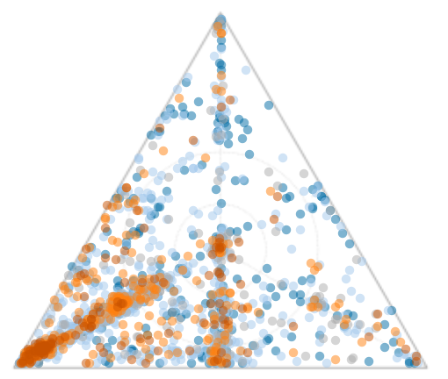
T4. In the example you gave, what mattered to people?
Prosperity
Prosperity
Surviving
Status
Surviving
Status

Slide 11
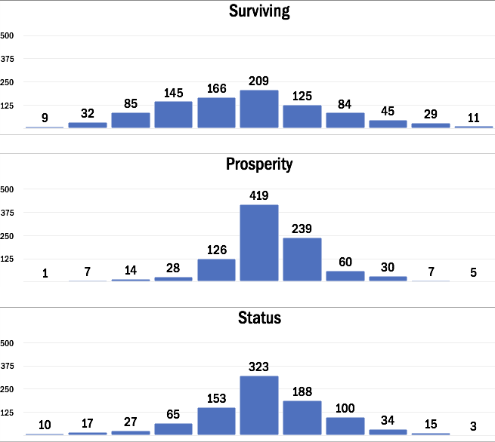
Reducing effect
No change
Increasing effect
الحياة حلوة 4
لمسات
قصه كفاح
حياتي في ٤سنين
عاطلون
يفرجها الله
توزيع الحمل
حياة إنسان بسيط
مغتربين
رد المعروف
الورثة
مستقبلي\ محامي يهرب
تطوير مهاراتي
لا حول ولا بوة الا بالله
الاصرار على الحياة
الرابطة
صعوبة حياتي
اصنع شيء لنفسك
كفاح 5
Concerning signs of negative deviancy
Most important and welcome shift

Slide 12
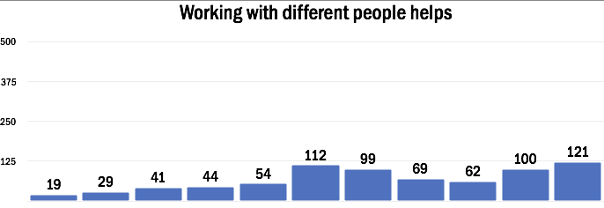
More subtle effects and indicators

Slide 13
At the end
Some people are worth more than others
بعض الناس لهم قيمة أكثر من غيرهم
Everyone should be treated the same
يجب معاملة الجميع بنفس الطريقة
-5 | -4 | -3 | -2 | -1 | 0 | 1 | 2 | 3 | 4 | 5
Everyone should be treated the same
يجب معاملة الجميع بنفس الطريقة
-5 | -4 | -3 | -2 | -1 | 0 | 1 | 2 | 3 | 4 | 5
Working with different people helps
العمل مع أشخاص متنوعين يساعد
Some people are worth more than others
بعض الناس لهم قيمة أكثر من غيرهم
Working with different people helps
العمل مع أشخاص متنوعين يساعد
-5 | -4 | -3 | -2 | -1 | 0 | 1 | 2 | 3 | 4 | 5

Slide 14
This study have changed my point of view to tend to social capital more than financial capital
When people able to survive they look for social status. Relationships are the base and through it, we develop skills and experience that lead you to financial capital
Quotes from beneficiary participants in analysis workshop, December 2017

Slide 15

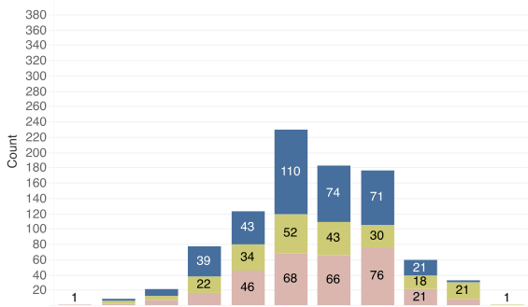
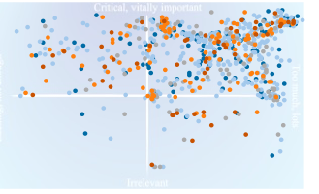
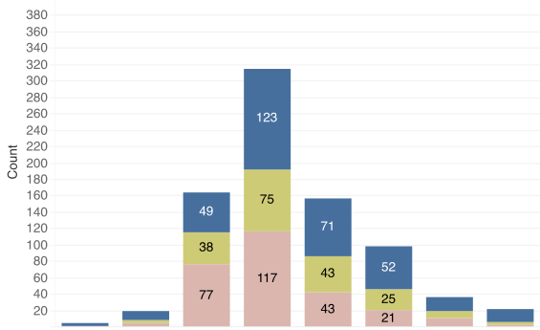
How much social capital?
ما مقدار رأس المال الإجتماعي؟
Social Capital
Critical, very important حرج
-5 | -4 | -3 | -2 | -1 | 0 | 1 | 2 | 3 | 4 | 5
Lacking, not enough قليل
Too much, lots كثير
How important is social capital?
ما اهمية رأس المال الإجتماعي؟
Irrelevant لا علاقة
-4 | -3 | -2 | -1 | 0 | 1 | 2 | 3 | 4

Slide 16
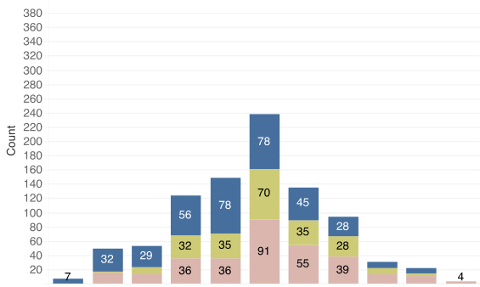
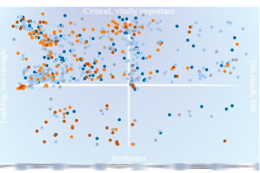
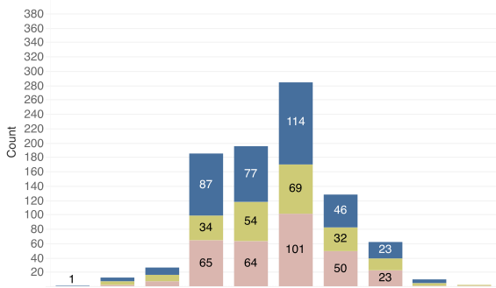
How much financial capital?
Financial Capital
Critical, very important حرج
-5 | -4 | -3 | -2 | -1 | 0 | 1 | 2 | 3 | 4 | 5
Lacking, not enough قليل
Too much, lots كثير
How important is financial capital?
Irrelevant لا علاقة
-4 | -3 | -2 | -1 | 0 | 1 | 2 | 3 | 4

Slide 17
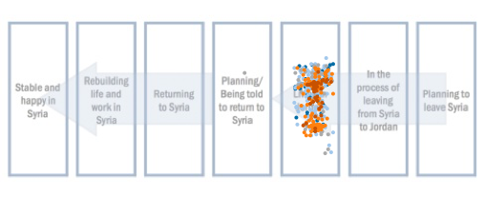
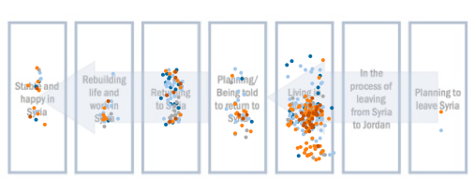
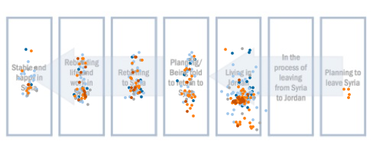
Where are you today?
Where do you want to be?
Where do you expect to be in 2 years?

Slide 18
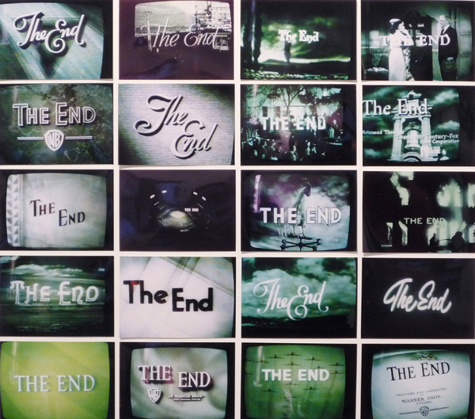
Tony Quinlan
Chief Storyteller
e: tony@narrate.co.uk
m: +44 (0) 7946 094 069

